Slide 1
SQL and Databases: Project Report – New Wheels
By Andrea Strough

Slide 2
Business Overview
TOTAL REVENUE
$ 124,714,086.32
TOTAL ORDERS
1000
TOTAL CUSTOMERS
994
AVG RATING
3.13
LAST QTR REVENUE
$23,346,780
AVR DAYS TO SHIP
98 days
% GOOD FEEDBACK
22%

Slide 3

CUSTOMER METRICS

Slide 4
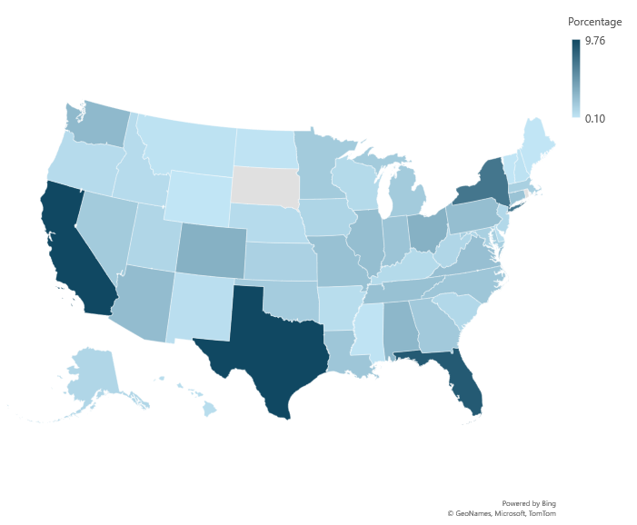
DISTRIBUTION OF CUSTOMERS ACROSS STATES
Observations / Findings:
About 35% of customers are in California, Texas, Florida and New York.
The District of Columbia is counted as state and it has the 5th larger number of customers, 3.52%.
The company doesn’t have any customer in South Dakota neither Rhode Island.

Slide 5
AVERAGE CUSTOMER RATING BY QUARTER
Observations / Findings:
The average customer rating wasn’t above Good in any quarter.
The average customer satisfaction went down from Good/Okay to Bad/Very Bad.
Customer satisfaction decreased continuously across quarters.
By the end of third quarter, the customer satisfaction was below average.

Slide 6
TREND OF CUSTOMER SATISFACTION
Observations / Findings:
For first quarter, about 60% of customer satisfaction was good and very good.
Positive reviews trend started going down by the third quarter.
By the last quarter, the trend reversed. About 60% of customer satisfaction was rated as very bad and bad.

Slide 7
TOP VEHICLE MAKERS PREFERRED BY CUSTOMERS
Observations / Findings:
The top 5 vehicle maker preferred by customer are Chevrolet, Ford, Toyota, Pontiac and Dodge.
Chevrolet has the highest percentage of preference with 8.35%, while Pontiac and Dodge are the lowest top 5 preferred vehicle makers with 5.03%.
Similar trend is shown when the top 5 vehicle maker are calculated by quantity sold.

Slide 8
MOST PREFERRED VEHICLE MAKE IN EACH STATE
state | Vehicle maker
Alabama | Dodge
Alaska | Chevrolet
Arizona | Pontiac
Arizona | Cadillac
Arkansas | Suzuki
Arkansas | Chevrolet
Arkansas | Pontiac
Arkansas | Volkswagen
Arkansas | Mitsubishi
Arkansas | GMC
California | Ford
California | Dodge
California | Audi
California | Nissan
California | Chevrolet
Colorado | Chevrolet
Connecticut | Chevrolet
Connecticut | Mercury
Connecticut | Maserati
Connecticut | Volvo
Delaware | Mitsubishi
District of Columbia | Chevrolet
Florida | Toyota
Georgia | Toyota
Hawaii | Ford
Hawaii | Toyota
Hawaii | Pontiac
Hawaii | Nissan
Hawaii | Cadillac
Hawaii | GMC
Idaho | Dodge
Illinois | Ford
Illinois | GMC
Illinois | Chevrolet
Indiana | Mazda
Iowa | Chrysler
Iowa | Chevrolet
Iowa | Hyundai
Iowa | Isuzu
Iowa | Dodge
Iowa | Mazda
Iowa | Porsche
Iowa | Jeep
Iowa | Ford
Iowa | Pontiac
Iowa | Subaru
Kansas | GMC
Kansas | Lexus
Kansas | Buick
Kansas | Mercedes-Benz
Kansas | Suzuki
Kansas | Honda
Kansas | Dodge
Kansas | Volkswagen
Kansas | Ford
Kansas | Mazda
Kansas | Maserati
Kansas | Nissan
Kansas | Saab
Kentucky | Acura
Kentucky | Mercury
Kentucky | Audi
Kentucky | Ram
Kentucky | Volvo
Kentucky | Pontiac
Kentucky | Nissan
Kentucky | Mercedes-Benz
Louisiana | BMW
Louisiana | Nissan
Louisiana | Ford
Louisiana | Pontiac
Louisiana | Kia
Maine | Mercedes-Benz
Maryland | Ford
Massachusetts | Dodge
Massachusetts | Chevrolet
Michigan | Ford
Minnesota | GMC
Mississippi | Dodge
Mississippi | Toyota
Missouri | Chevrolet
Montana | Chevrolet
Montana | Mitsubishi
Montana | Dodge
Nebraska | Chevrolet
Nebraska | Mercedes-Benz
Nebraska | Volkswagen
Nebraska | Nissan
Nebraska | Pontiac
Nebraska | Toyota
Nebraska | Cadillac
Nevada | Pontiac
New Hampshire | Chrysler
New Hampshire | Lincoln
New Hampshire | Lexus
New Jersey | Mercedes-Benz
New Jersey | Hyundai
New Mexico | Dodge
New York | Toyota
New York | Pontiac
North Carolina | Volvo
North Dakota | Hyundai
North Dakota | Ford
Ohio | Chevrolet
Oklahoma | Toyota
Oklahoma | Ferrari
Oklahoma | Mazda
Oregon | Toyota
Pennsylvania | Toyota
South Carolina | Acura
South Carolina | Buick
South Carolina | BMW
South Carolina | Kia
South Carolina | Mazda
South Carolina | Mitsubishi
South Carolina | Dodge
South Carolina | Jaguar
South Carolina | Isuzu
Tennessee | Mazda
Texas | Chevrolet
Utah | Maybach
Utah | Volkswagen
Utah | Isuzu
Utah | Subaru
Utah | Lincoln
Utah | Chevrolet
Utah | Oldsmobile
Utah | Pontiac
Utah | Dodge
Utah | Buick
Vermont | Mazda
Virginia | Ford
Washington | Chevrolet
West Virginia | Mercedes-Benz
Wisconsin | Pontiac
Wisconsin | Chevrolet
Wisconsin | Acura
Wisconsin | Mazda
Wisconsin | Nissan
Wisconsin | Cadillac
Wisconsin | Dodge
Wisconsin | Honda
Wyoming | Buick
Observations / Findings:
There are some states that have more than one vehicle maker preferred by customer.

Slide 9

REVENUE METRICS

Slide 10
TREND OF PURCHASES BY QUARTER
Observations / Findings:
By the first quarter, the company has over 300 orders.
This trend decreased continuously through the next quarters.
The total orders dropped over 100 orders by the last quarter.

Slide 11
QUARTER ON QUARTER % CHANGE IN REVENUE
Observations / Findings:
The percental variation is negative for all three quarters.
There was slightly improvement in the variation revenue on third quarter; however, it’s still negative.
The fourth quarter shows the largest variation, up to -20.13%.

Slide 12
TREND OF REVENUE AND ORDERS BY QUARTER
Observations / Findings:
The trends for both revenue and orders show a continuous decline through all quarters.
It seems there is a correlation between orders and revenue.

Slide 13

SHIPPING METRICS

Slide 14
AVERAGE DISCOUNT OFFERED BY CREDIT CARD TYPE
Observations / Findings:
The credit card type with the highest discount is Laser, with 0.644%.
The company offers discount to all credit card type.
The lowest discount is 0.584 for Dinners-Club International.

Slide 15
TIME TAKEN TO SHIP ORDERS BY QUARTER
Observations / Findings:
The time taken to ship orders has increased significantly over the quarters.
The company started shipping its orders within 57 days; however, this time increased sharply through quarters 2 and 3.
By quarter 4, the shipping time was about 174 days. This is 3 times longer than quarter 1.

Slide 16
INSIGHTS AND RECOMMENDATIONS

Slide 17
The total of orders dropped significantly through the quarters.
It seems there is a correlation between orders and revenue. If the number of order goes down, the revenue trend also decreases.
The shipping time has worsened. By quarter 4, the shipping time was over 3 times longer than the shipping time on quarter 1.
There could be a correlation between shipping time with the customer satisfaction rating. The longer the delivery takes, the more negative scores on the scale.
Reduce the shipping time. Delivery time should not take more than 57 days as it was on first quarter. If possible, lower that number.
Concentrate sales in the top 5 territories where most customer are located. California, Texas, Florida, New York and The District of Columbia.
Not offer discount for credit card payments. Instead offer discount for quantity purchased.
Ask customers about what was the best part of the whole purchase experience and what would need improvement. These questions would help the company to learn about its customer’s opinion.

